Slide 1
Banking Case-study
Project Gladiator Phase

Slide 2
Team Members
Adith Shetty-Team Leader
Dhruv Vyas
Olivia Biswas
Shefali Shetty

Slide 3
Problem Statement
Online banking system is specifically developed for internet banking for balance enquiry, funds transfer to another account, change of profile information and account statement. The traditional way of maintaining details of a user in a bank was to enter the details and record them. Every time the user needs to perform some transaction they have to go to bank and perform the necessary actions, which may not be so feasible all the time.
Here, we provide an automation for banking system through Internet. The aim is not only automation but also a better customer experience by providing a User Interface which is easily comprehendible by any person. The website should also provide customer support so that the users get responded to their queries immediately and maintain the transparency so that the users should be aware of all the charges associated with the transaction.

Slide 4
Mandatory Modules
Create Account
Login
Transaction(Fund Transfer)
Change Login and Transaction Password
Forgot Id/Password

Slide 5
Project Flow
A visitor at first will request for account creation in the bank website by providing required details. On submitting their details, user will receive a service reference number to track the status of account creation status. All new account creation request will be approved by Admin after verifying all the related documents.
Customer’s account will be created on approval and a unique customer id, account number and initial login and transaction password will be delivered to the customer on registered email and the same will be information via SMS on phone. On successful creation of account, customer now will be able to avail all the services on online banking system

Slide 6
Categorization
Admin Module
Login
Approve Account Creation
User Module
Login
Register
Fund Transfer
(NEFT,RTGS,IMPS)
Password Change
Account Unlocking
Forgot customer id/Password

Slide 7
Snapshots

Slide 8
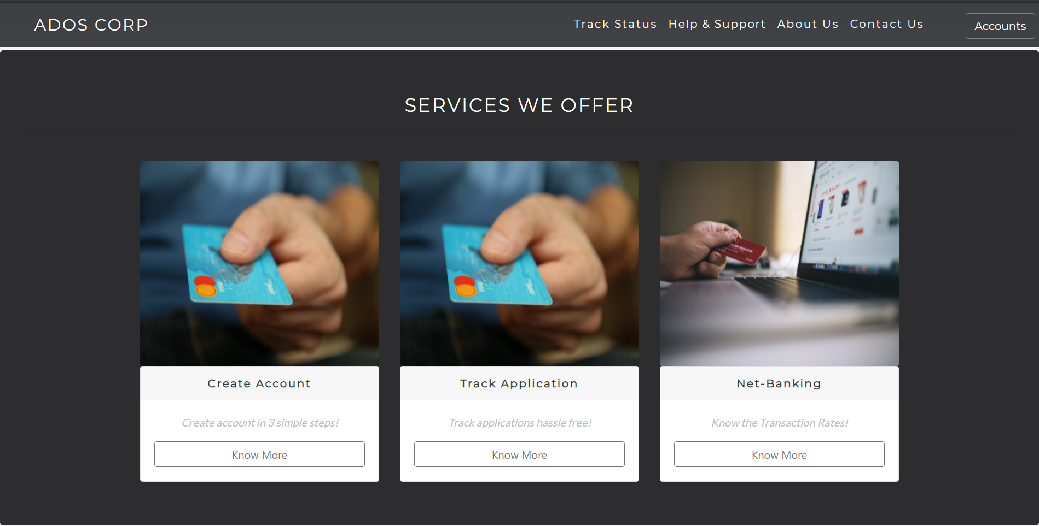
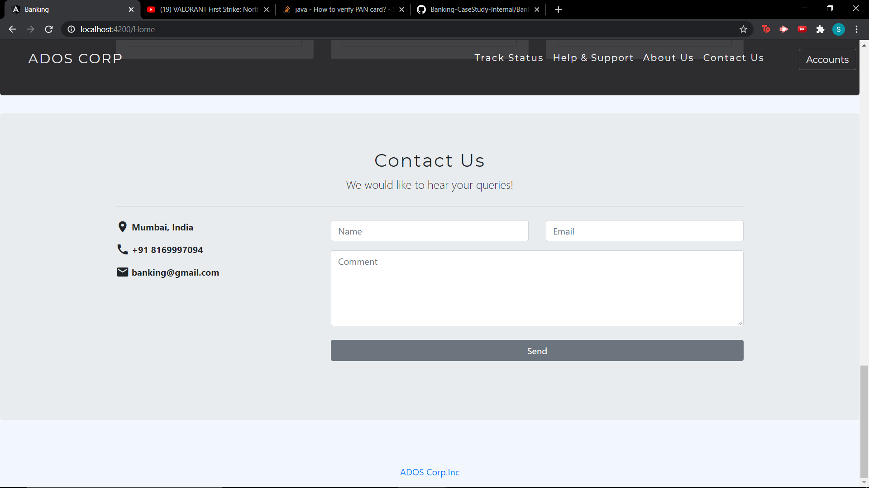
Home Page
Help & Support
Contact Us

Slide 9
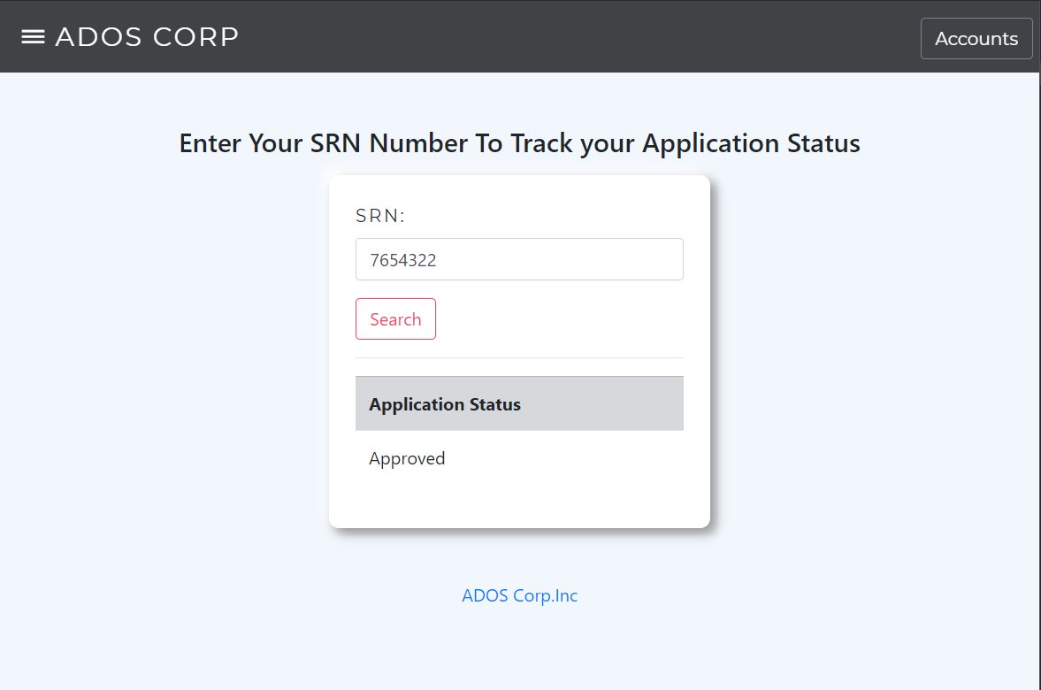
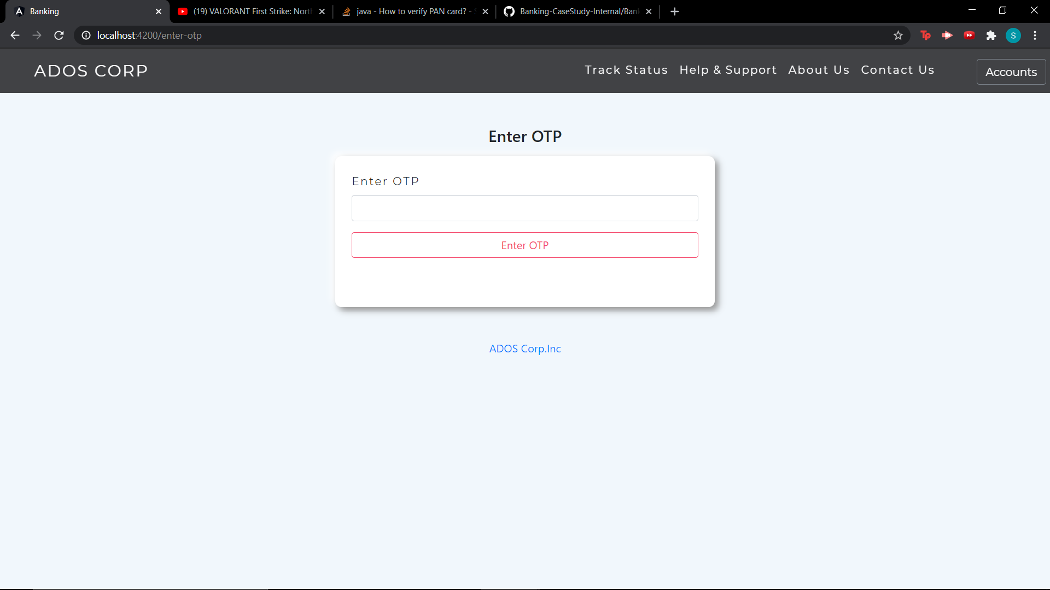
Some Features
Track Status
Forgot Credentials

Slide 10
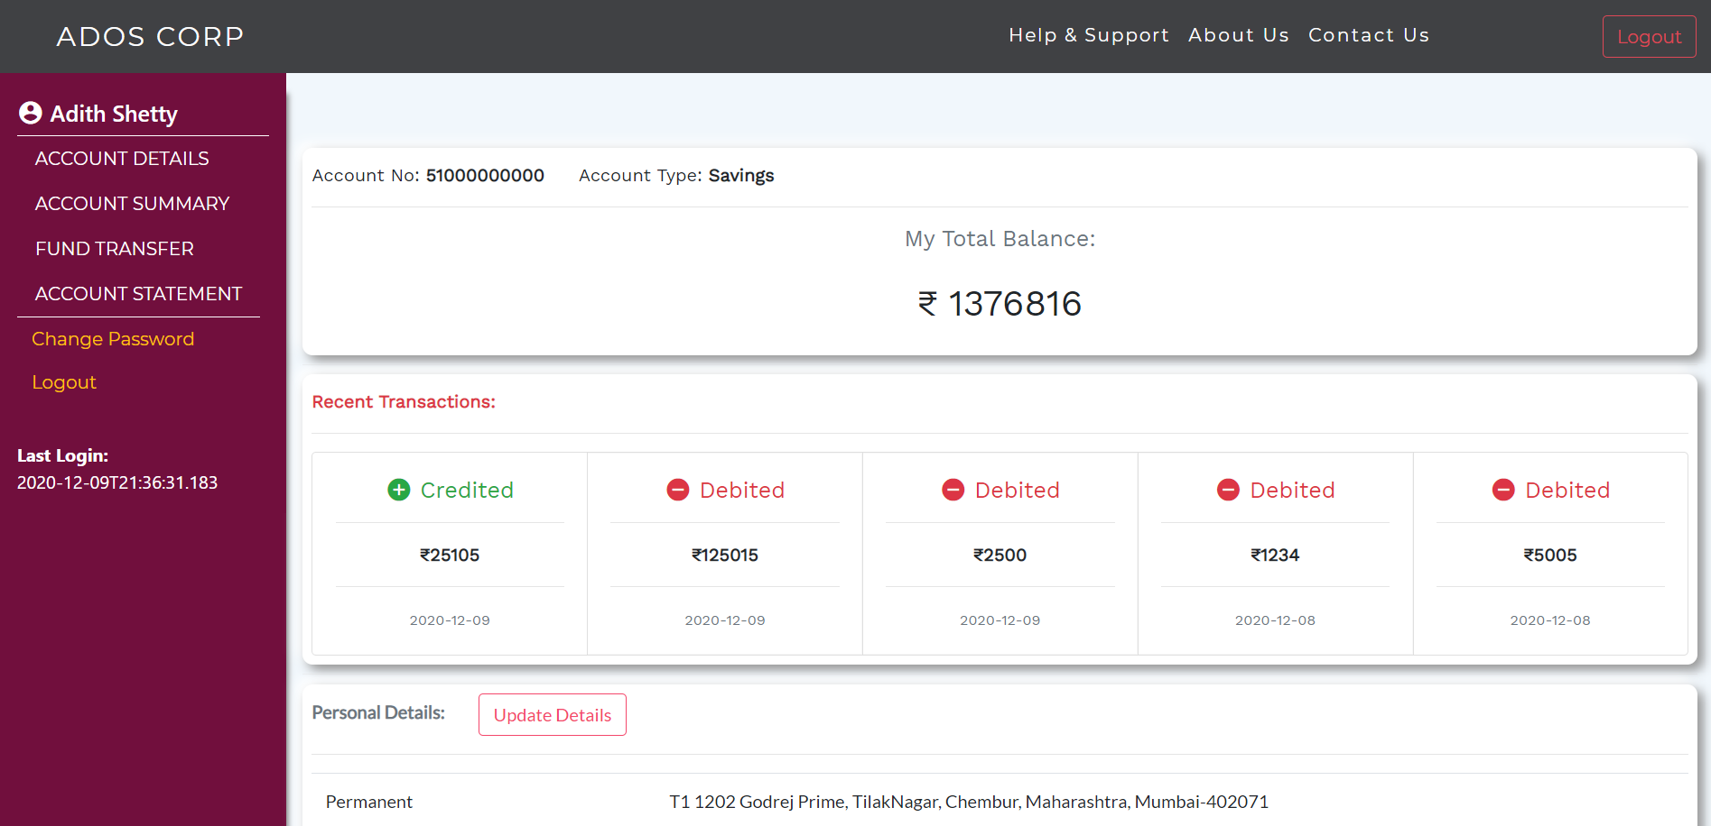
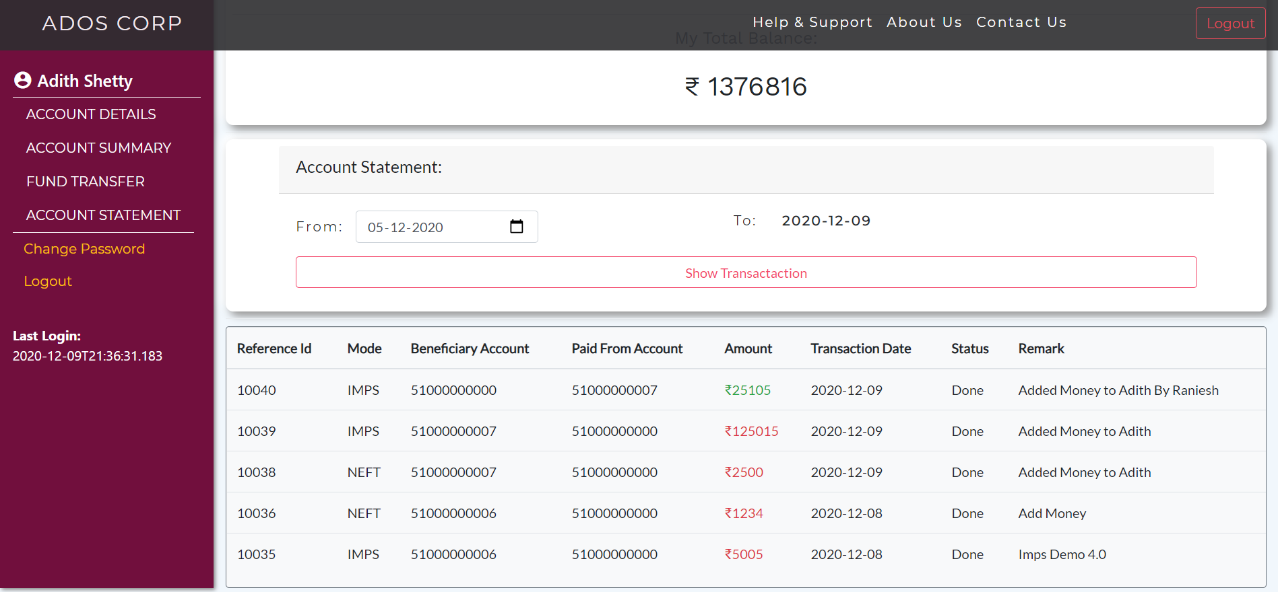
User Dashboard
Account Details
Account Statement

Slide 11
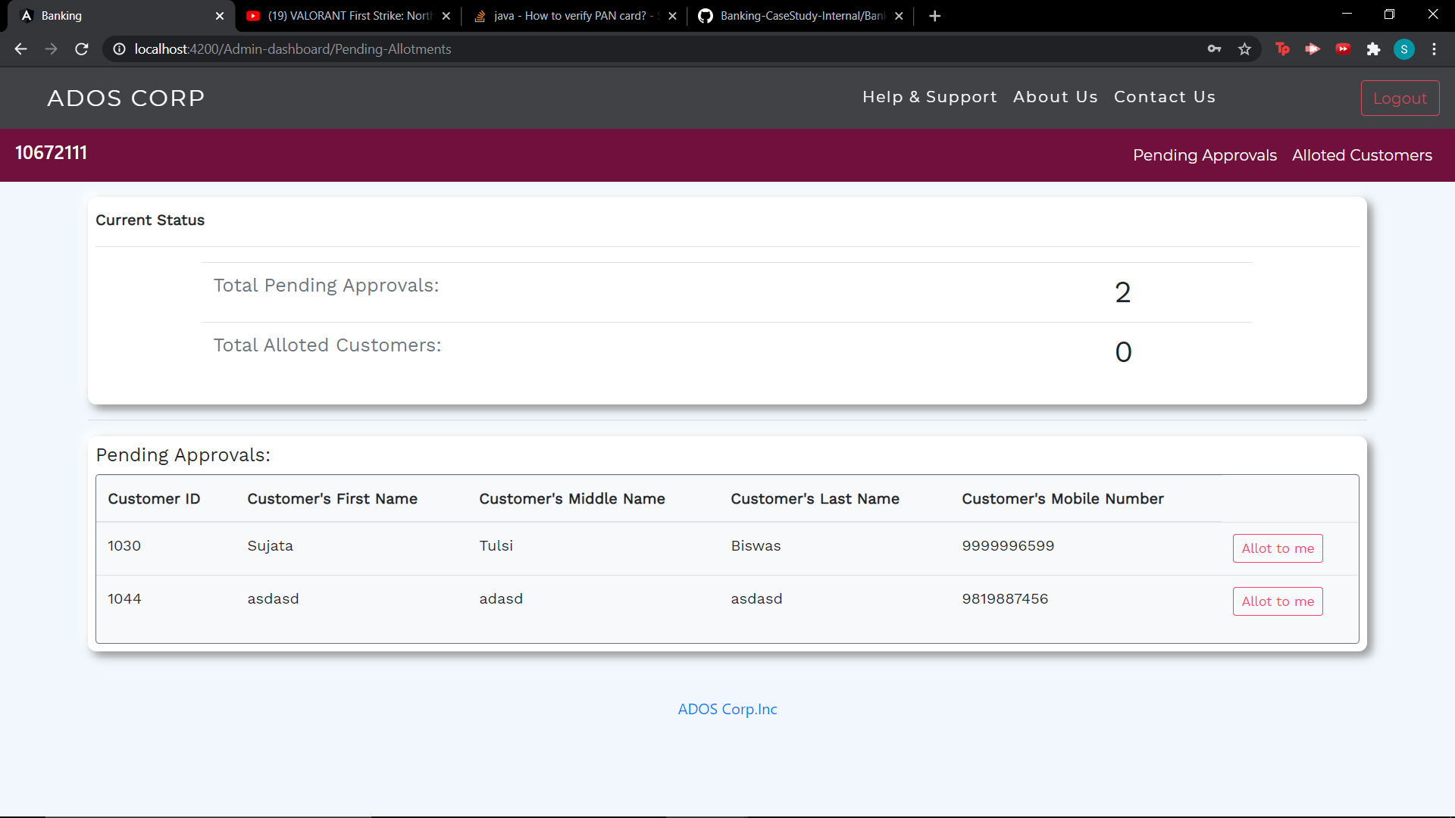
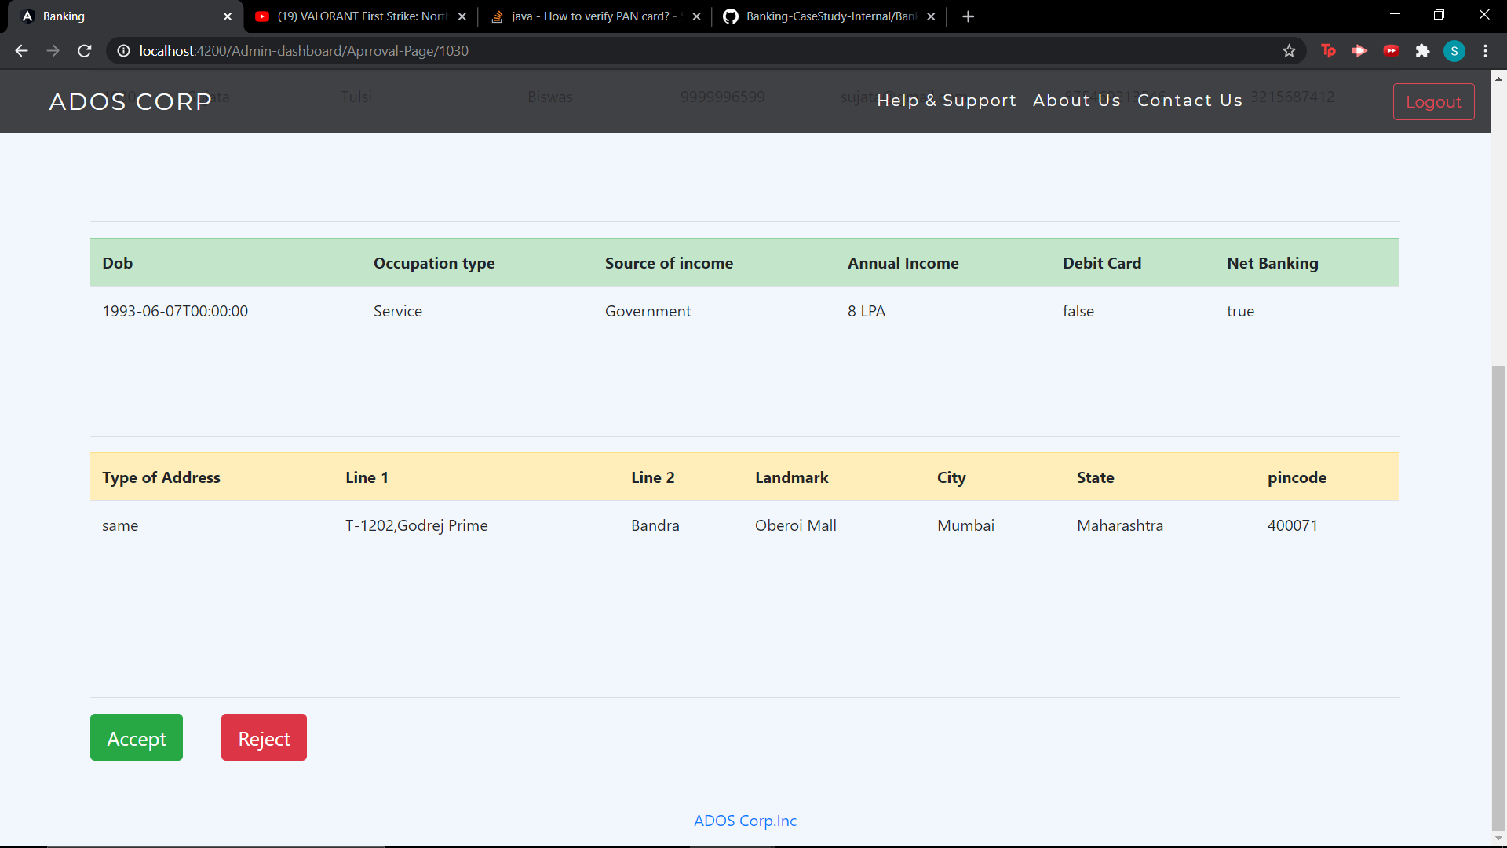
Admin Dashboard
Pending Approvals
Approval Page

Slide 12
Thank You!

